Slide 1
MOOSE– Massively Object-Oriented Simulation Environment
the multiphysics framework

Slide 2
MOOSE Physics Modules
Chemical Reactions Contact External PETSc Solver Fluid Properties Function Expansion Tools Heat Conduction Level Set Navier Stokes
Phase Field Porous Flow rDG Stochastic Tools Tensor (solid) Mechanics XFEM Shallow Water (work in progress) Ray Tracing (work in progress)

Slide 4
Governing Equations

Slide 5
Input Files

Slide 6
Input File

Slide 8
Run Example via Command Line

Slide 9
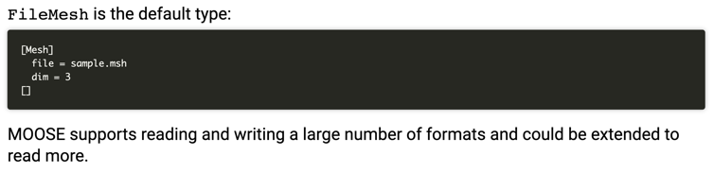
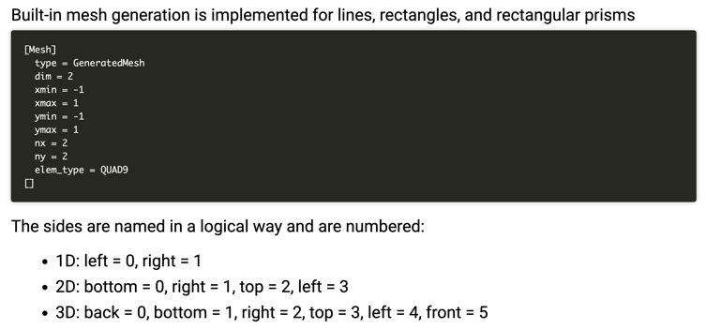
Mesh

Slide 10
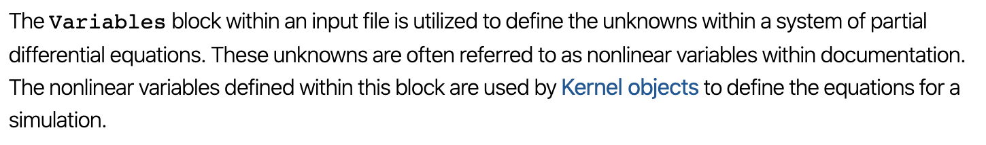
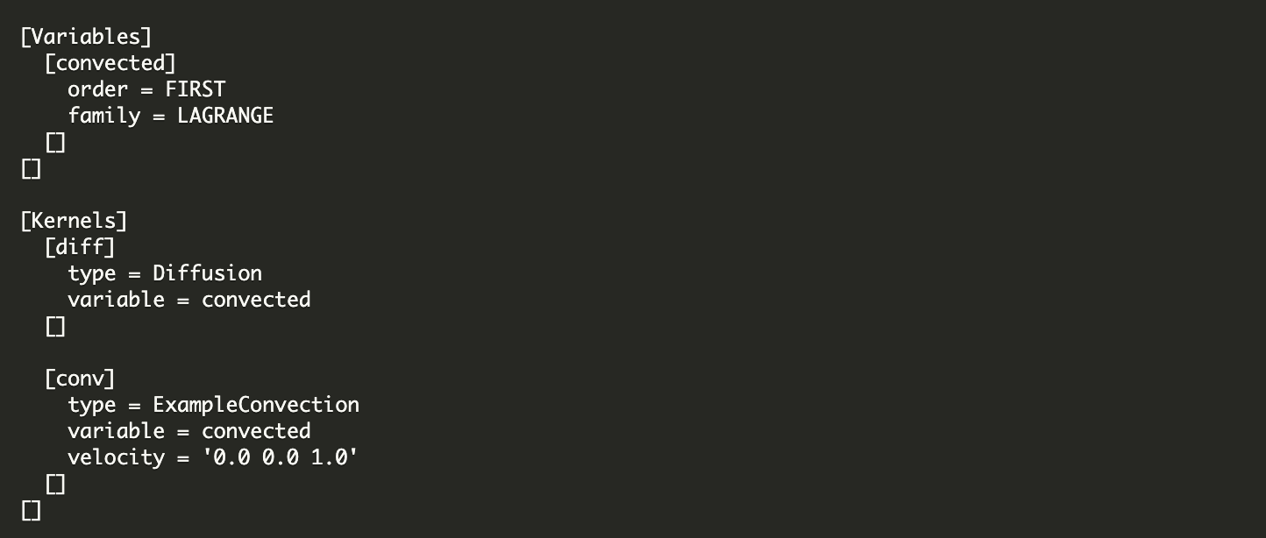
Variables

Slide 11
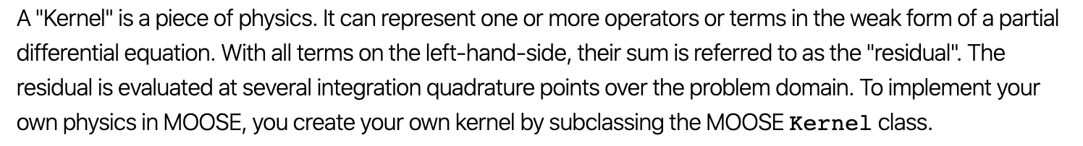
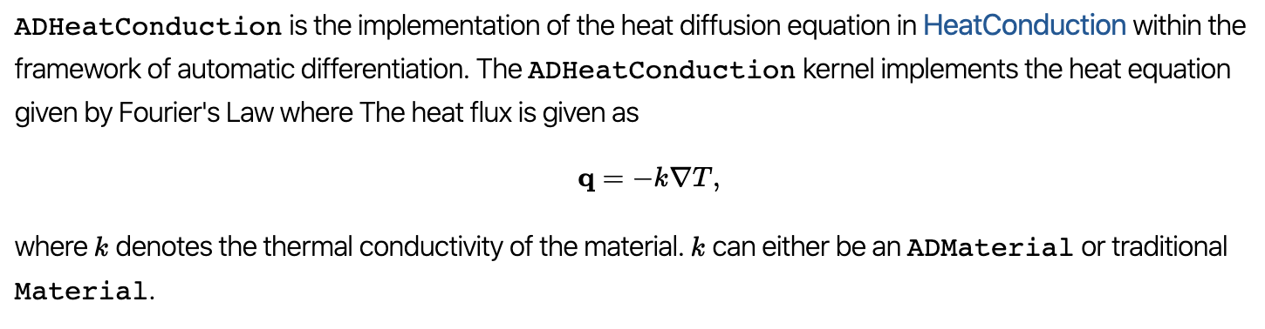
Kernel

Slide 12
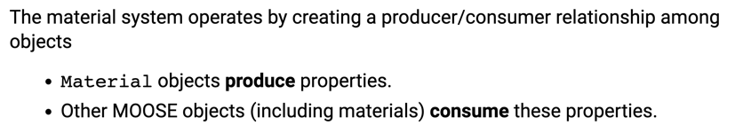
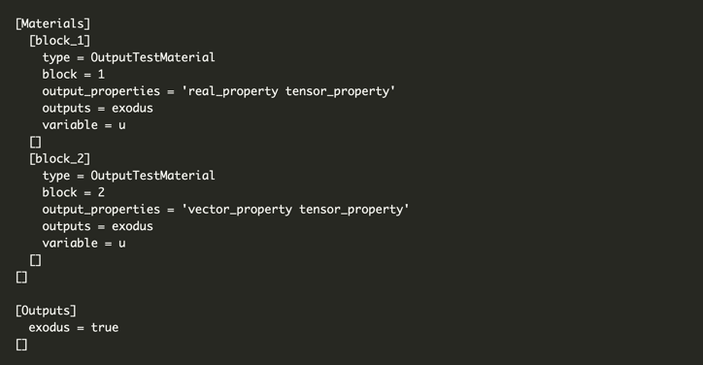
Materials

Slide 13
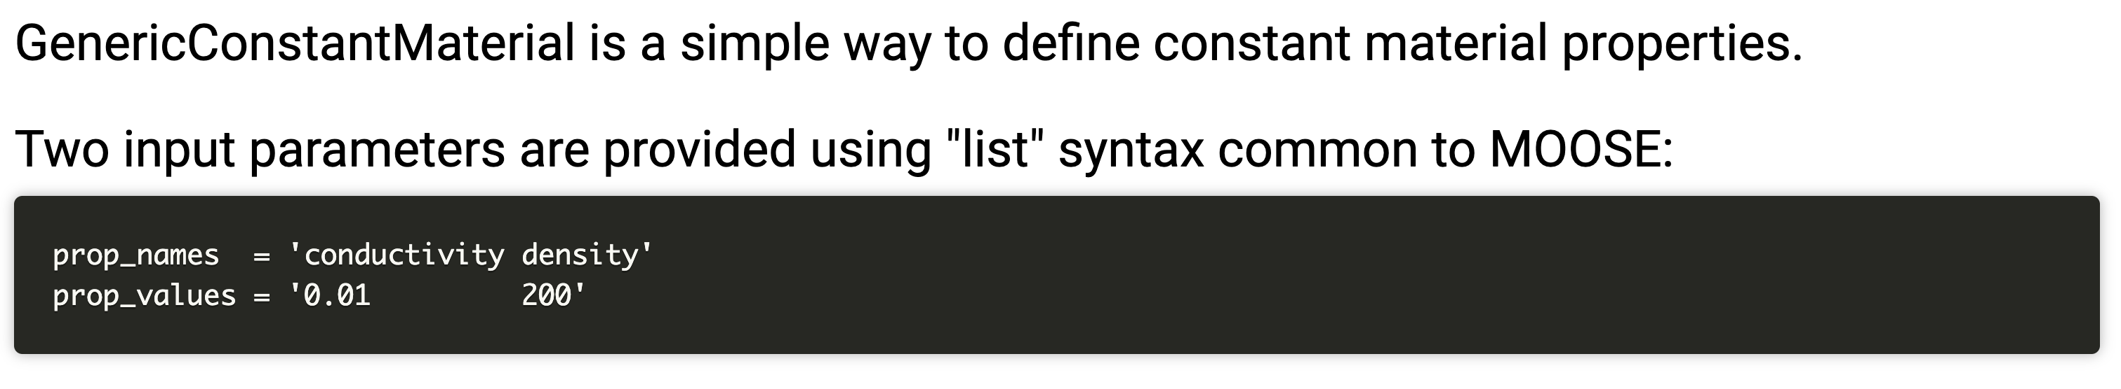
GenericConstantMaterials

Slide 14
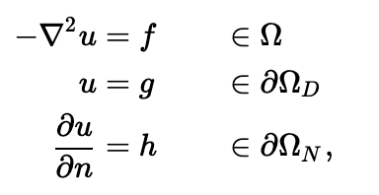
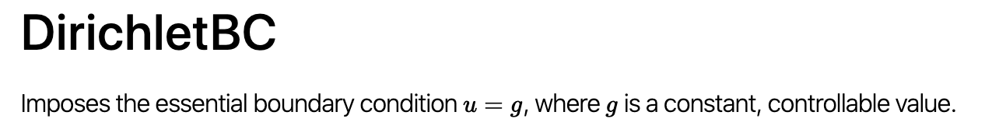
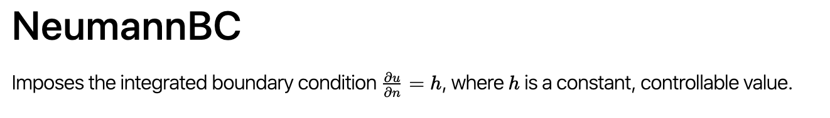
Boundary Conditions

Slide 15
MOOSE Solve Types

Slide 16
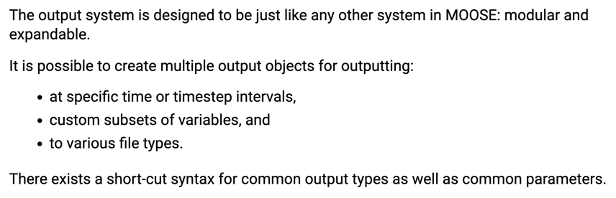
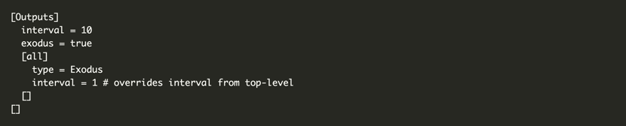
Outputs

Slide 17
Visualization
Two ways to visualize
Peacock: MOOSE GUI
Paraview: External software program that can read exodus files
I recommend downloading paraview
It is free and open source
Very flexible
Less buggy than peacock
But, if you try peacock, and it works for you, great!

Slide 18
Paraview
Open new
Move forward in time
Select Properties

Slide 19
MOOSE C++ Fundamentals
Will not cover here, if you feel like you need some background, go to below site, where they have some basics
https://mooseframework.org/workshop/#/10

Slide 20
Tutorials/Examples
A stepped example/tutorial lives in:
moose/tutorials/darcy_thermo_mech
This tutorial has 11 steps where they add complexity to a moose input file/physics problem
This is a VERY valuable exercise to work through
Tip : ./mooseapp-opt --dump > syntax.out creates a file “syntax.out” with all of the moose syntax and usage
Better tip: mooseframework.org is a great resource with everything documented

Slide 21
Building MOOSE on RDFMG cluster
mkdir projects
cd projects
git clone https://github.com/idaholab/moose.git
module load GCC/8.3.0-2.32
module load OpenMPI/4.0.1-GCC-8.3.0-2.32
module load cmake/3.6.3
module load PETSc/3.9.1-foss-2018a-downloaded-deps
module load Python/3.7.4-GCCcore-8.3.0
cd moose
./scripts/update_and_rebuild_libmesh.sh ## Note: this step takes a while
cd test
make -j 4
./run_tests -j 4

Slide 22
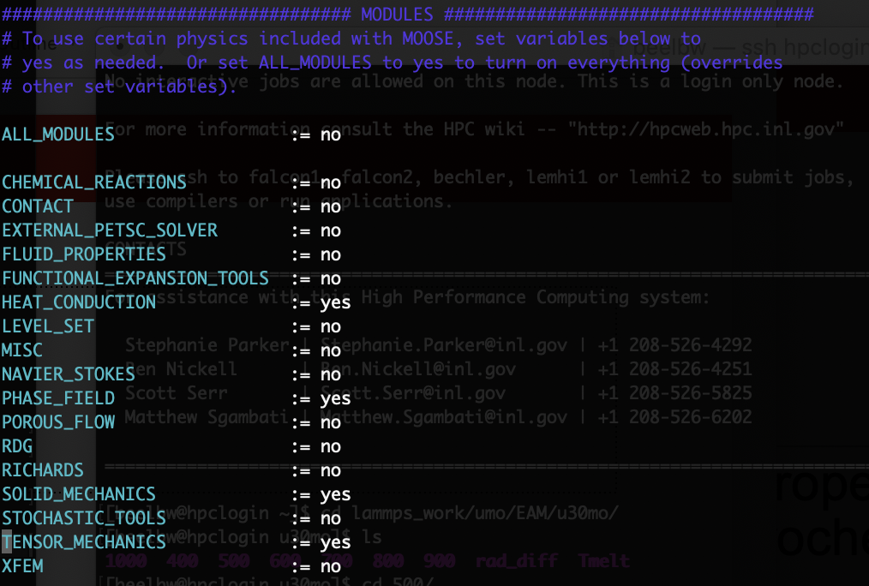
Making your own App and compiling
Edit makefile to match right->
vi Makefile

Slide 23
Handy bash commands
ssh username@rdfmg.ne.ncsu.edu : allows you to get on the cluster
sftp username@rdfmg.ne.ncsu.edu : allows you to transfer files to/from cluster
ls : list files in a directory; pwd: print working directory; cd : change directory; cp : copy a file
vi : file editor
i : edit the file; esc : stop editing
:w : save file
:q : close file
slurm is the submission manager
sbatch submit.sh: submit job with submit script
squeue : check status of jobs
I will provide you will a submit script that you will need to lightly edit

Slide 24
MOOSE Project
0.5 cm
0.1 cm
0.1 cm
Fuel pin dimensions listed
Fuel thermal conductivity: 0.3 W/cm-K
Cladding thermal conductivity: 0.17 W/cm-K
Gap thermal conductivity: 0.1 W/cm-K
Outer cladding: 500 K
Mesh: 100x100
Solve temperature profile for:
Steady-state: Volumetric/Areal heating rate: Q = 250 W/cm²
Solve for centerline temperature vs time
Transient: Volumetric/Areal heating rate: Q = 150*EXP(-0.03*time)+250, for up to t=200
Will submit input files, output files, and your results in powerpoint
1 cm
Fuel
Cladding
Gap

Slide 25
Next Time
Your all’s presentations!
Will also do MOOSE questions, and topics, if time
Reminder: office hours tomorrow, good opportunity if you have MOOSE questions

